Slide 1

Games with Uncertainty (pt 1)
Chris Kiekintveld

Slide 2
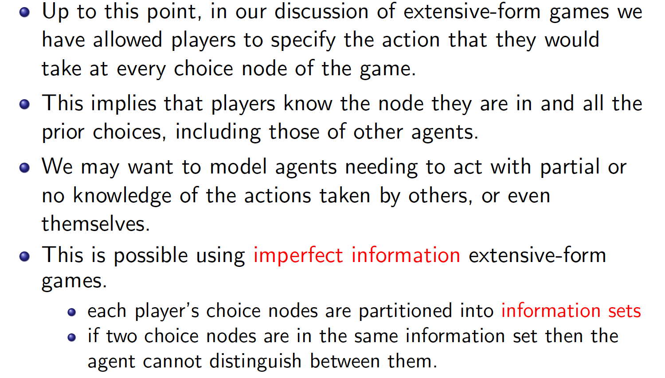
Modeling Uncertainty in EFGs

Slide 3
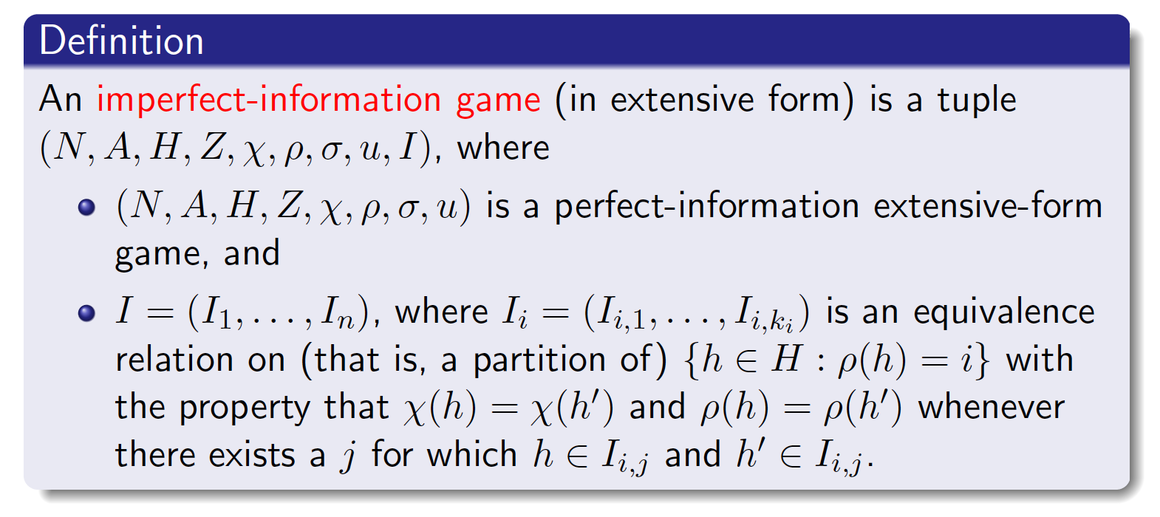
Formal Definition

Slide 4
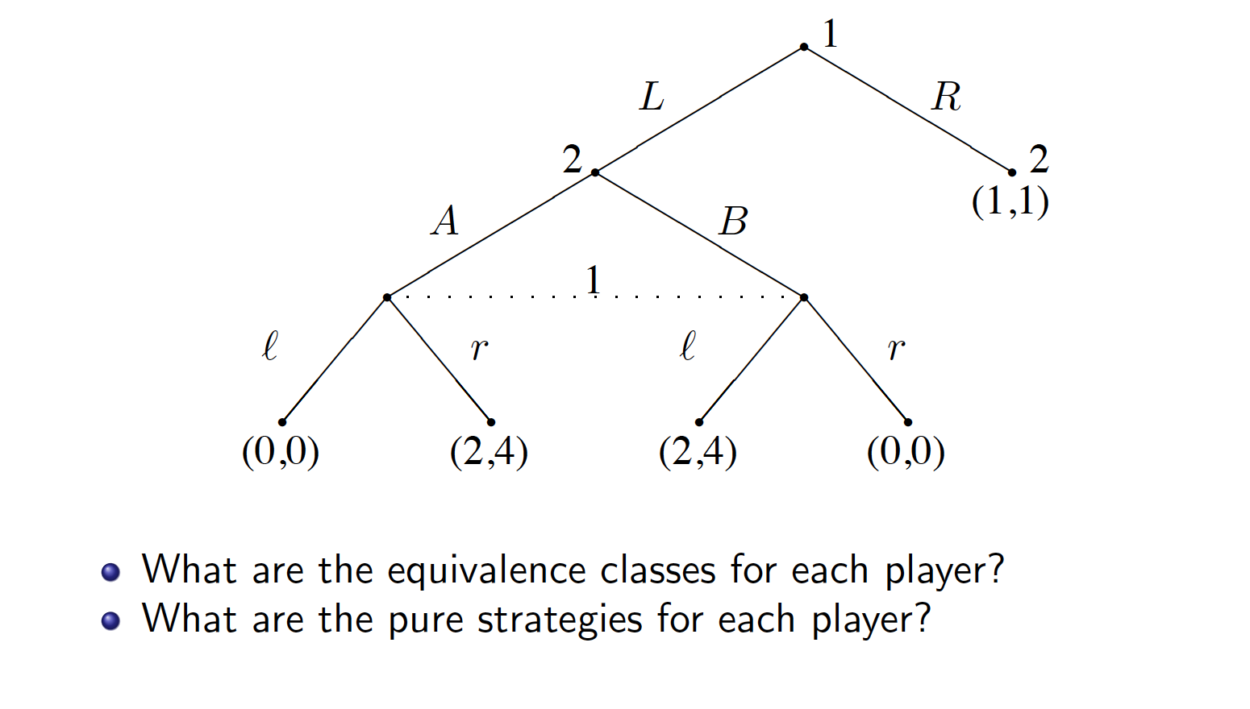
Example

Slide 5
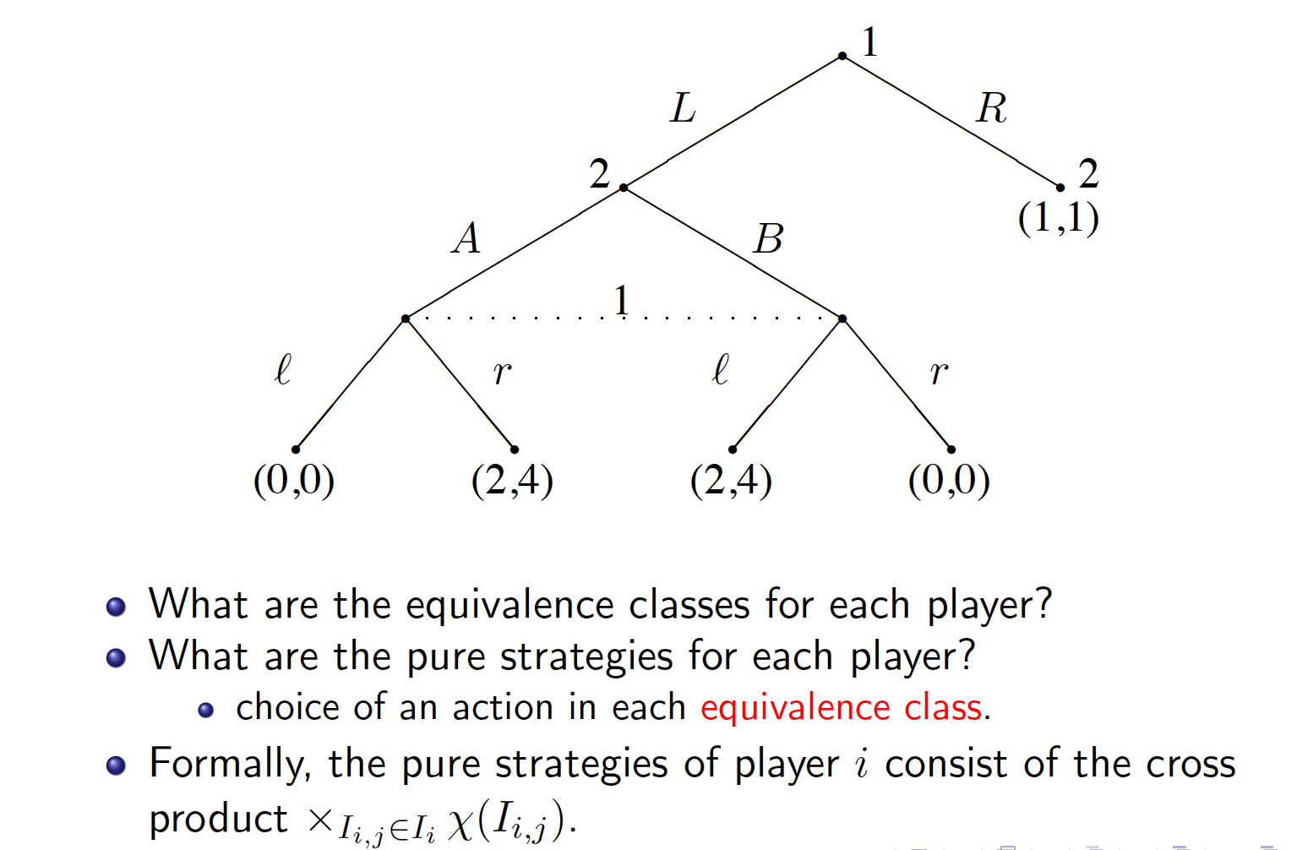
Example

Slide 6
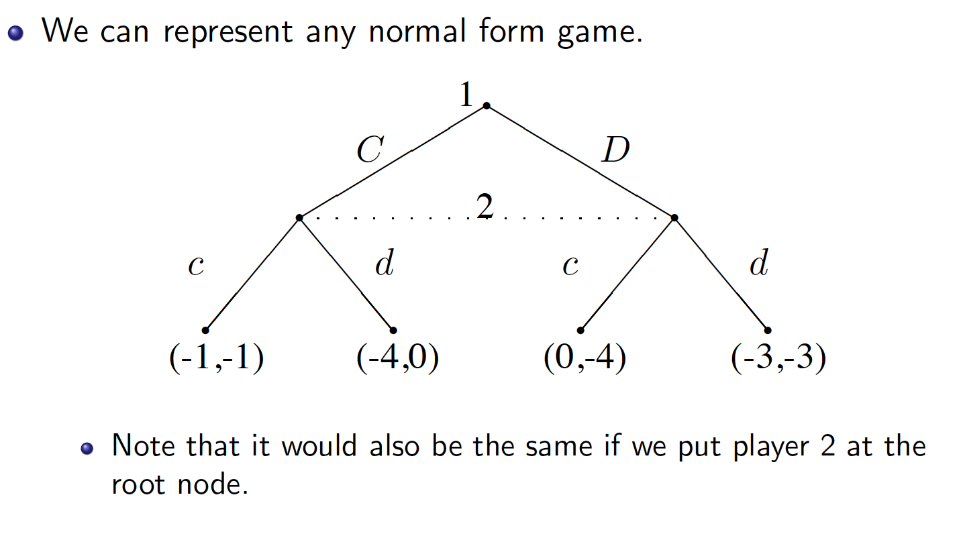
Connection to NFG

Slide 7
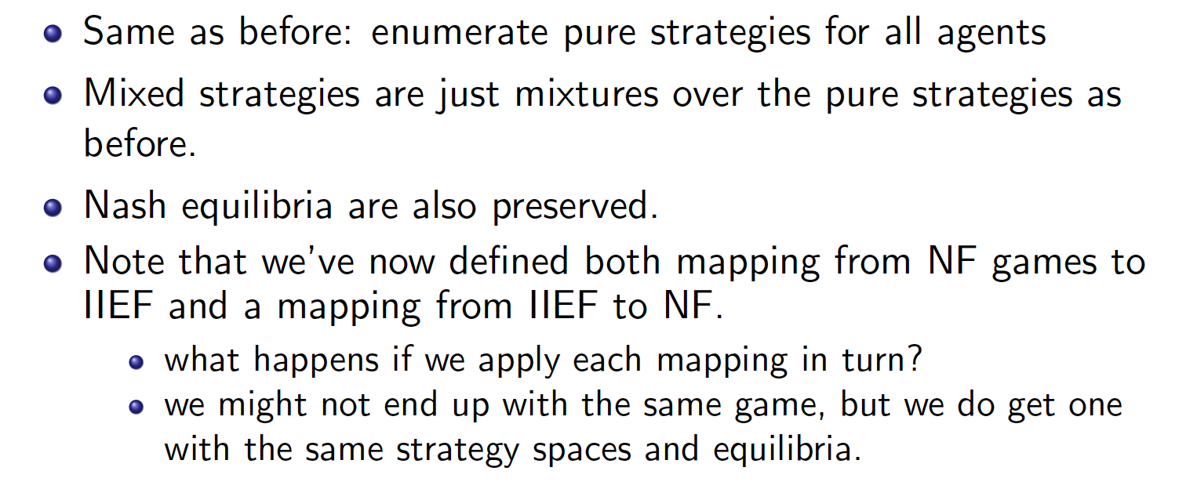
Induced Normal Form

Slide 8
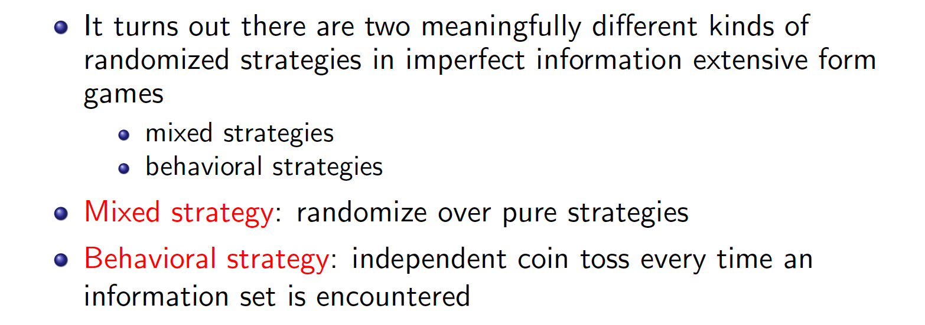
Randomized Strategies

Slide 9
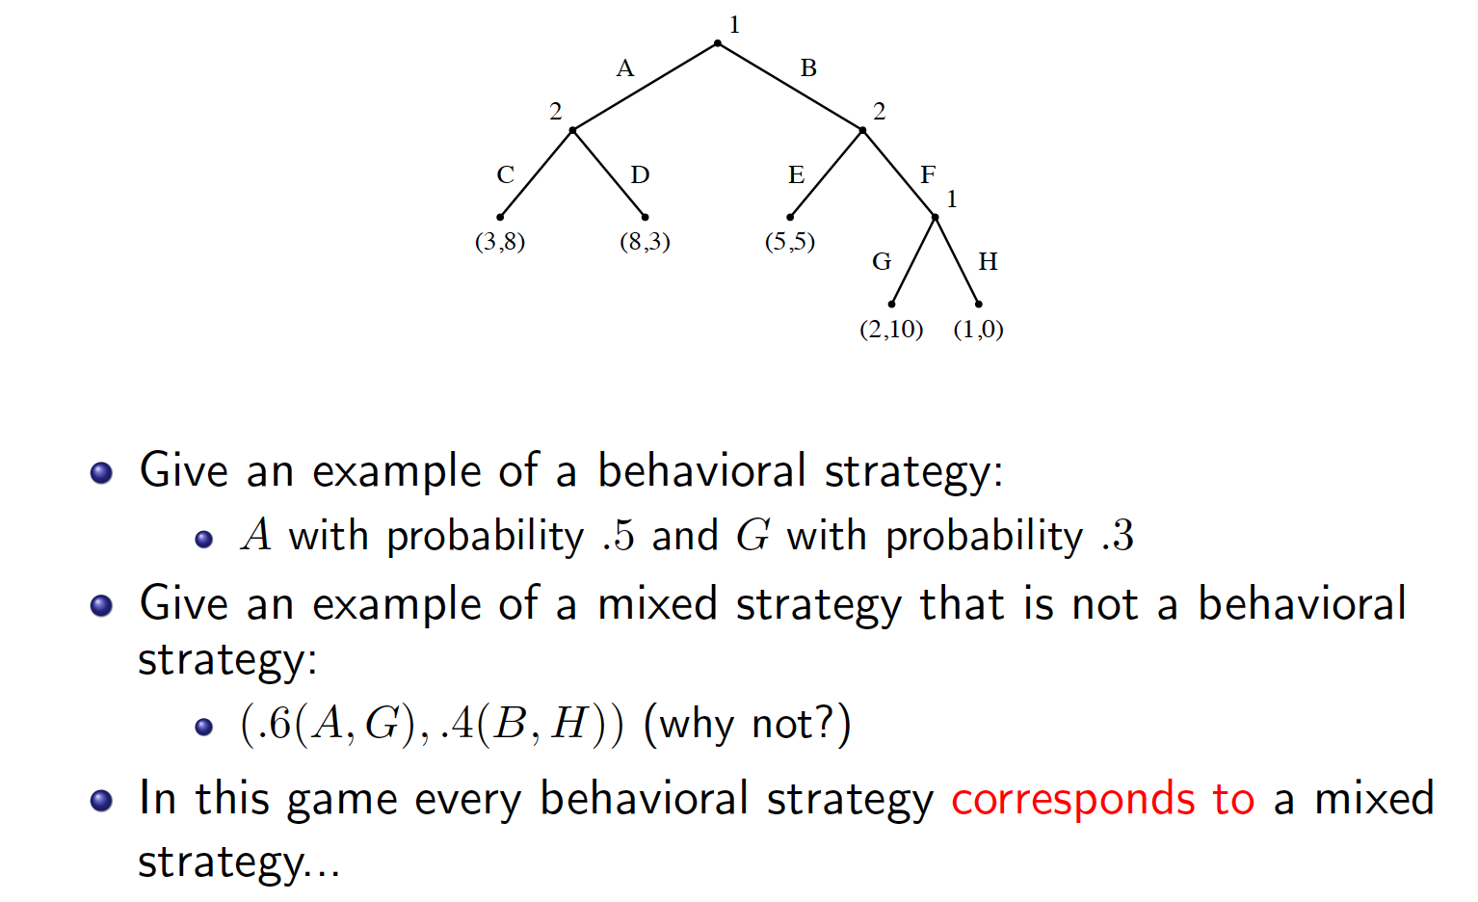
Randomized Strategy Example

Slide 10
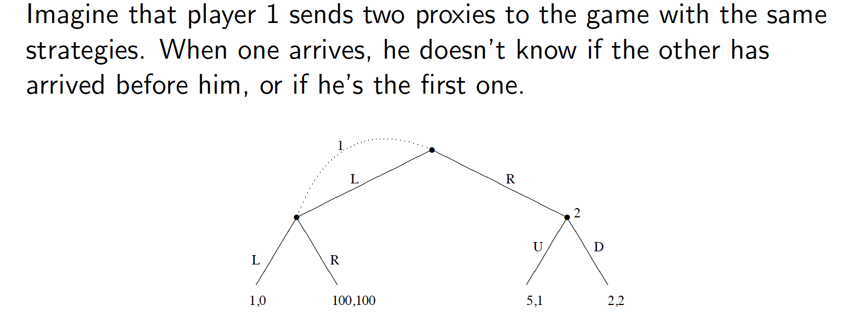
Imperfect Recall
In games with imperfect recall, mixed strategies
can be different from behavioral strategies

Slide 11
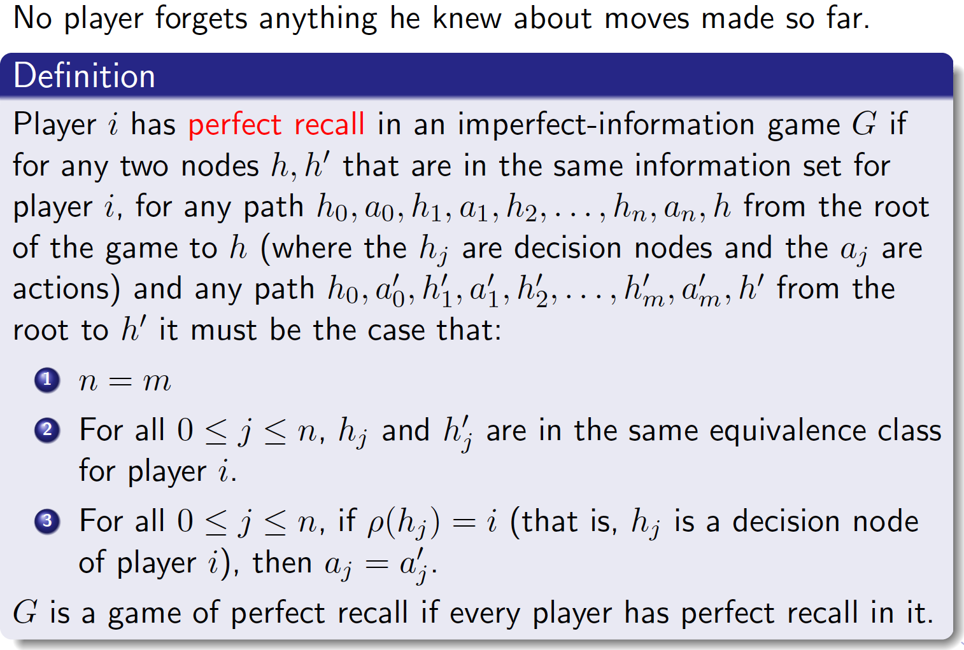
Perfect Recall: Mixed and Behavioral Strategies Coincide

Slide 12
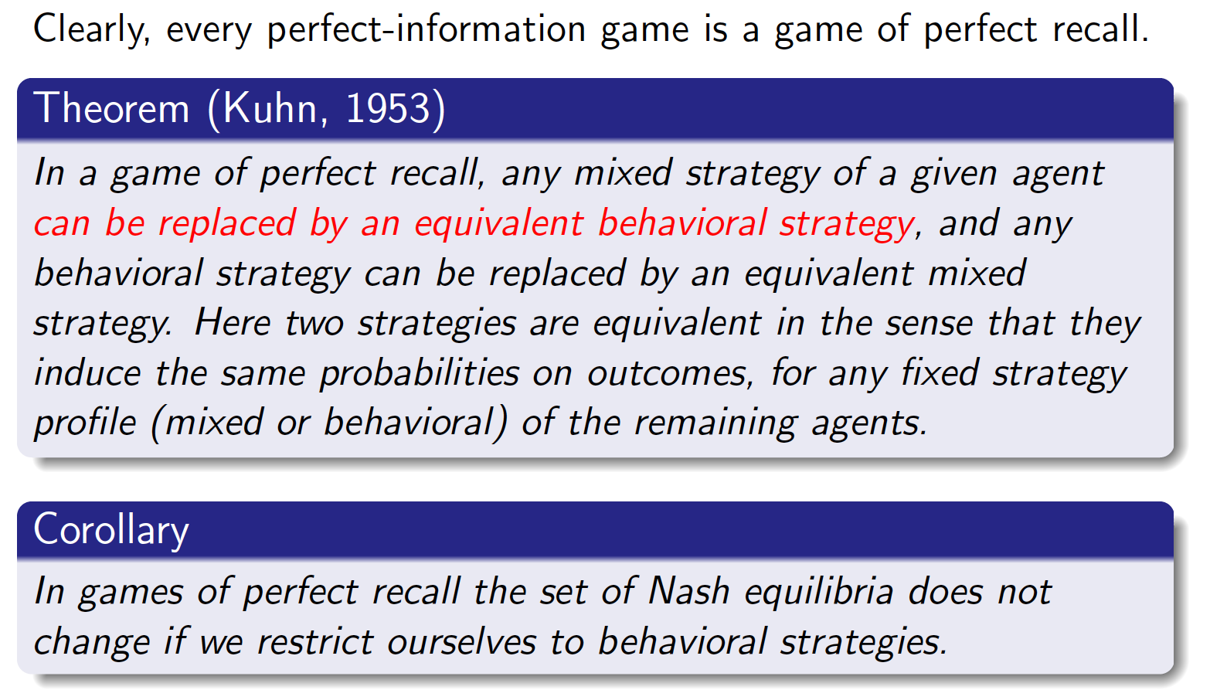
Perfect Recall

Slide 13
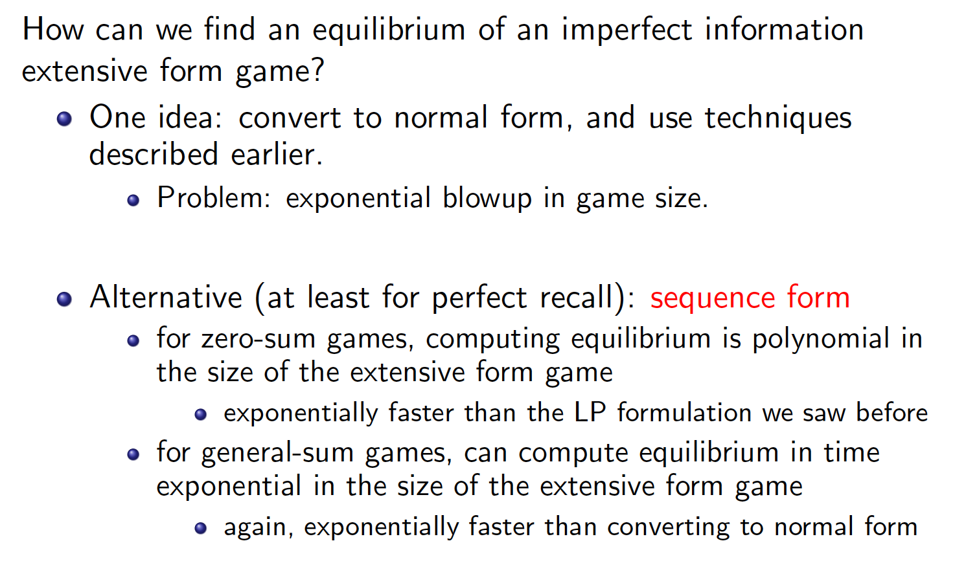
Computing Equilibria

